Slide 1
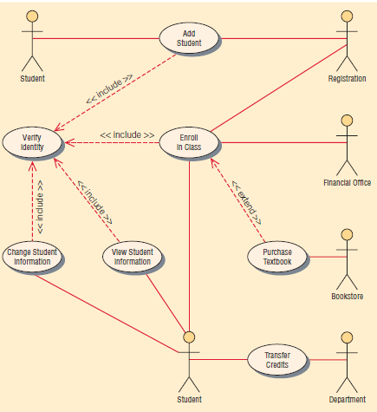
Figure 18.6 A use case example of student enrollment
Kendall & Kendall
18-<number>
Notes:
Use case diagrams provide the basis for creating other types of diagrams such as class diagrams and activity diagrams.

Slide 2
Figure 18.8 Specialized symbols are used to draw an activity diagram
Kendall & Kendall
18-<number>

Slide 3
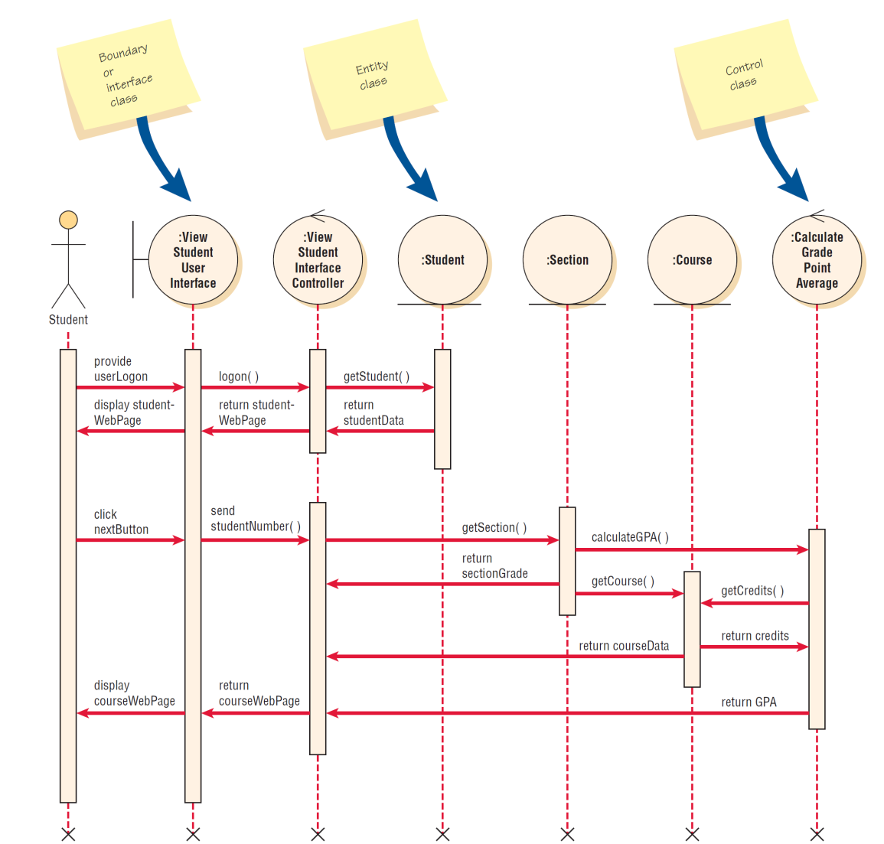
Kendall & Kendall
18-<number>
Notes:
1. Include the actor from the use case diagram in the enhanced sequence diagram. This will
be a stick figure from the use case diagram. There may be an additional actor on the right
side of the diagram, such as a credit card company or bank.
2. Define one or more interface classes for each actor. Each actor should have his or her own
interface class.
3. Create prototype Web pages for all human interfaces.
4. Ensure each use case has one control class, although more may be created during the
detailed design. Look for that control class and include it in the sequence diagram.
5. Examine the use case to see what entity classes are present. Include these on the diagram.
6. Realize that the sequence diagram may be modified again when doing detailed design,
such as creating additional Web pages or control classes (one for each Web form
submitted).
7. To obtain a greater degree of reuse, consider moving methods from a control class to an
entity class.

Slide 4
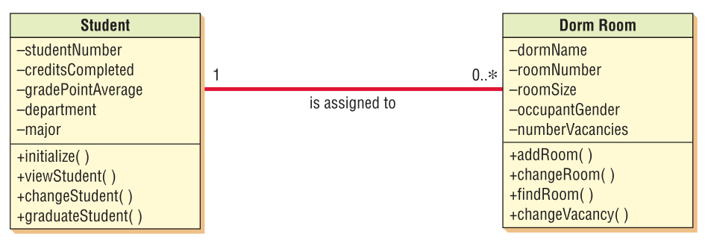
Association
Kendall & Kendall
18-<number>

Slide 5
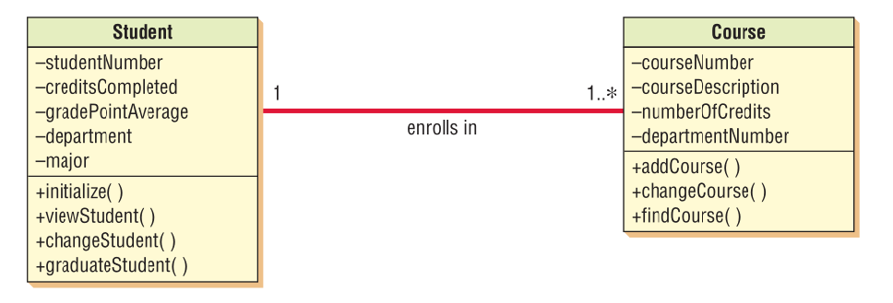
Association
Kendall & Kendall
18-<number>

Slide 6
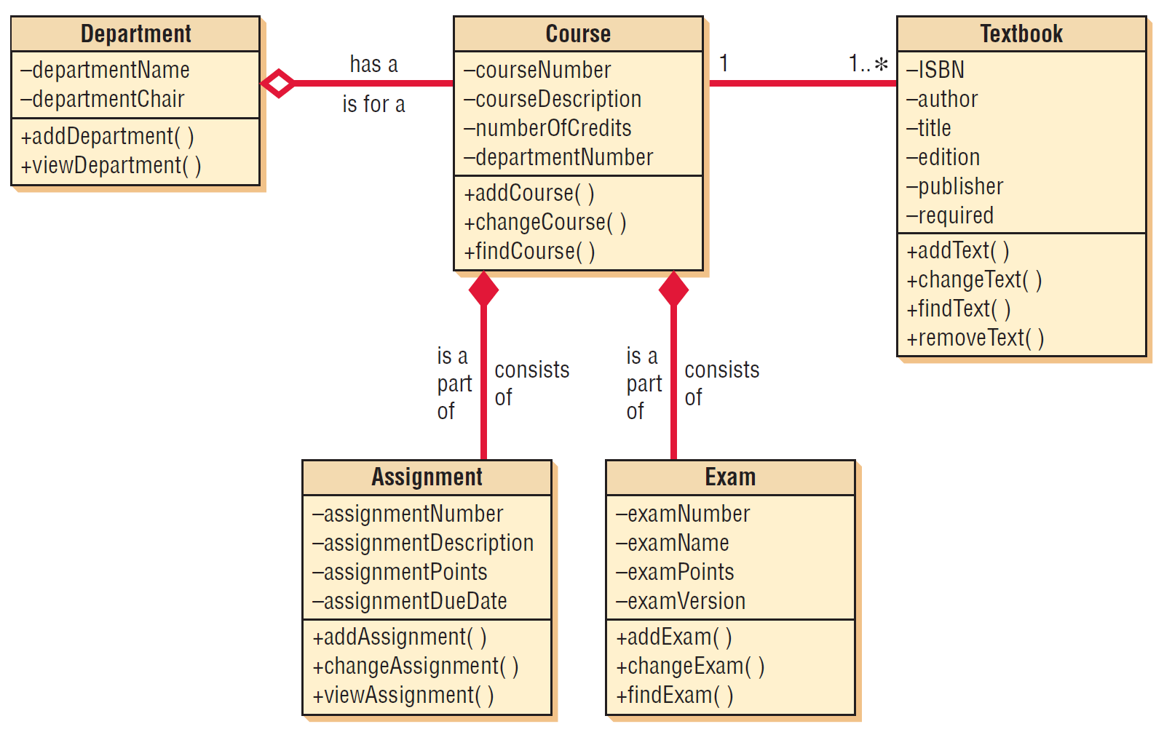
Figure 18.13 A class diagram for course offerings. The filled-in diamonds show aggregation and the empty diamond shows a whole-part relationship
Kendall & Kendall
18-<number>

Slide 7
Whole/Part Relationships
When one class represents the whole object, and other classes represent parts
Categories
  Aggregation
  Collection
  Composition
Kendall & Kendall
18-<number>
Notes:
When one class represents the whole object, and other classes represent parts – the whole acts as a container for the parts.

Slide 8
Aggregation
A “has a” relationship
Provides a means of showing that the whole object is composed of the sum of its parts
Kendall & Kendall
18-<number>

Slide 9
Collection
Consists of a whole and its members
Members may change, but the whole retains its identity
A weak association
Kendall & Kendall
18-<number>
Notes:
Examples are a library with books or a voting district with voters.

Slide 10
Composition
The whole has a responsibility for the parts, and is a stronger relationship
If the whole is deleted, all parts are deleted
Kendall & Kendall
18-<number>
Notes:
Example: an insurance policy with riders.

Slide 11
Figure 18.13 A class diagram for course offerings. The filled-in diamonds show aggregation and the empty diamond shows a whole-part relationship
Kendall & Kendall
18-<number>

Slide 12
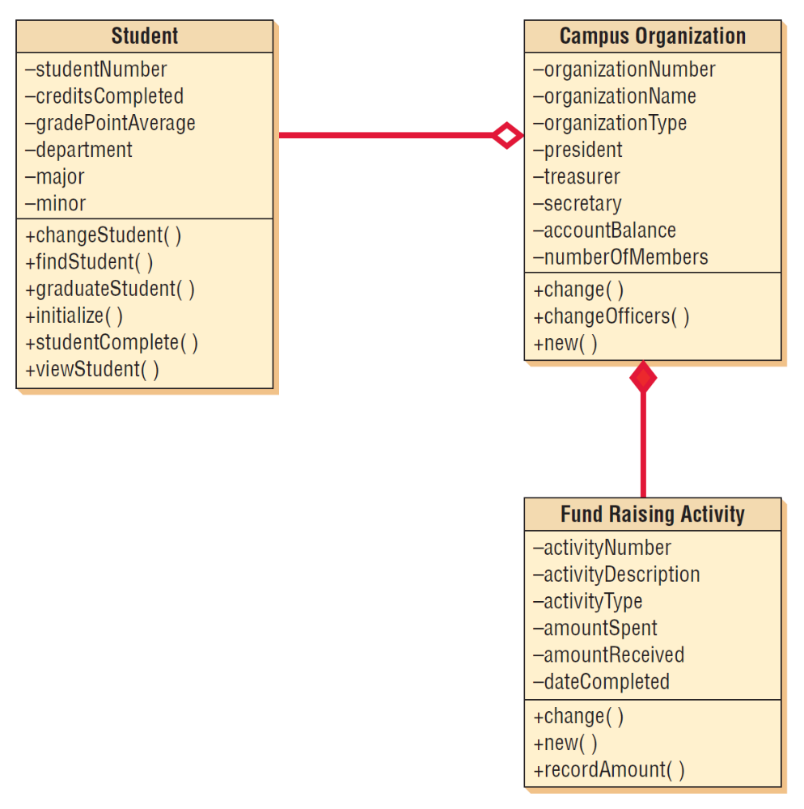
Figure 18.19 An example of whole-part and aggregation relationships
Kendall & Kendall
18-<number>

Slide 13
CRC Cards and Object Think
CRC
  Class
  Responsibilities
  Collaborators
CRC cards are used to represent the responsibilities of classes and the interaction between the classes
Kendall & Kendall
18-<number>
Notes:
CRC cards are created based on scenarios that outline system requirements.

Slide 14
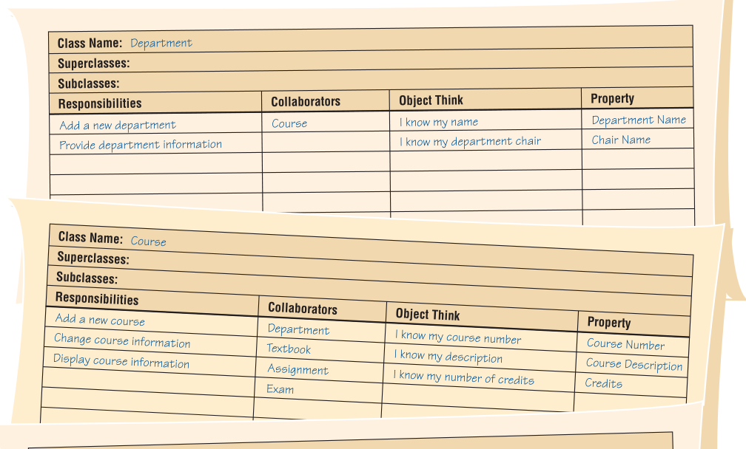
CRC cards for course offerings show how analysts fill in the details for classes, responsibilities, and collaborators, as well as for object think statements and property names
Kendall & Kendall
18-<number>
Notes:
The purpose of the Object Think column and the property column is to clarify thinking and help move toward creating the UML diagram.

Slide 15
Commonly Used UML Diagrams
Use case diagram
  Describing how the system is used
  The starting point for UML modeling
Use case scenario
  A verbal articulation of exceptions to the main behavior described by the primary use case
Activity diagram
  Illustrates the overall flow of activities
Kendall & Kendall
18-<number>

Slide 16
Commonly Used UML Diagrams (Continued)
Sequence diagrams
  Show the sequence of activities and class relationships
Class diagrams
  Show classes and relationships
Statechart diagrams
  Show the state transitions
Kendall & Kendall
18-<number>
Notes:
Each use case may create one or more sequence diagrams.
Statechart diagrams – useful for determining class methods.

Slide 17
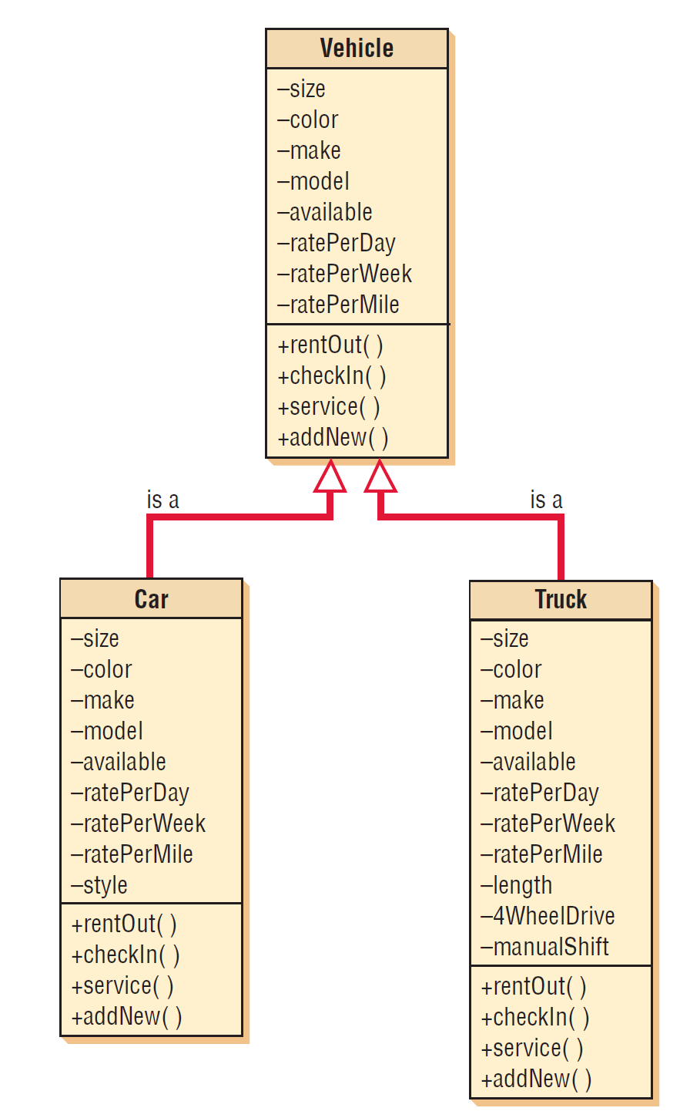
Figure 18.2 A class diagram showing inheritance. Car and truck are specific examples of vehicles and inherit the characteristics of the more general class vehicle
Kendall & Kendall
18-<number>

Slide 18
CRC Cards and Object Think
CRC
  Class
  Responsibilities
  Collaborators
CRC cards are used to represent the responsibilities of classes and the interaction between the classes
Kendall & Kendall
18-<number>
Notes:
CRC cards are created based on scenarios that outline system requirements.

Slide 19
CRC cards for course offerings show how analysts fill in the details for classes, responsibilities, and collaborators, as well as for object think statements and property names
Kendall & Kendall
18-<number>
Notes:
The purpose of the Object Think column and the property column is to clarify thinking and help move toward creating the UML diagram.

Slide 20
Interacting during a CRC Session
Identify all the classes you can
Creating scenarios
Identify and refine responsibilities
Kendall & Kendall
18-<number>
Notes:
Identify all the classes you can – when all classes have been identified, the analysts can then compile them, weed out the illogical ones, and write each one on its own card.
Creating scenarios – actually walkthroughs of system functions.
The responsibilities will eventually evolve into methods in the UML.
The think statements can later be converted to attributes in the UML.

Slide 21
The Unified Modeling Language (UML) Concepts and Diagrams
Things
Relationships
Diagrams
Kendall & Kendall
18-<number>
Notes:
UML provides a standardized set of tools to document the analysis and design of a software system.
Things - the objects.
Relationships - the glue that holds things together.
Diagrams - categorized as either structure or behavioral.

Slide 22
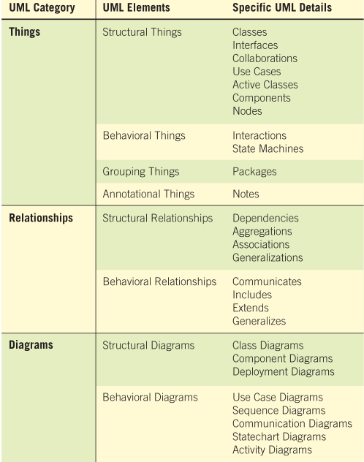
Kendall & Kendall
18-<number>

Slide 23
Commonly Used UML Diagrams
Use case diagram
  Describing how the system is used
  The starting point for UML modeling
Use case scenario
  A verbal articulation of exceptions to the main behavior described by the primary use case
Activity diagram
  Illustrates the overall flow of activities
Kendall & Kendall
18-<number>

Slide 24
Commonly Used UML Diagrams (Continued)
Sequence diagrams
  Show the sequence of activities and class relationships
Class diagrams
  Show classes and relationships
Statechart diagrams
  Show the state transitions
Kendall & Kendall
18-<number>
Notes:
Each use case may create one or more sequence diagrams.
Statechart diagrams – useful for determining class methods.

Slide 25
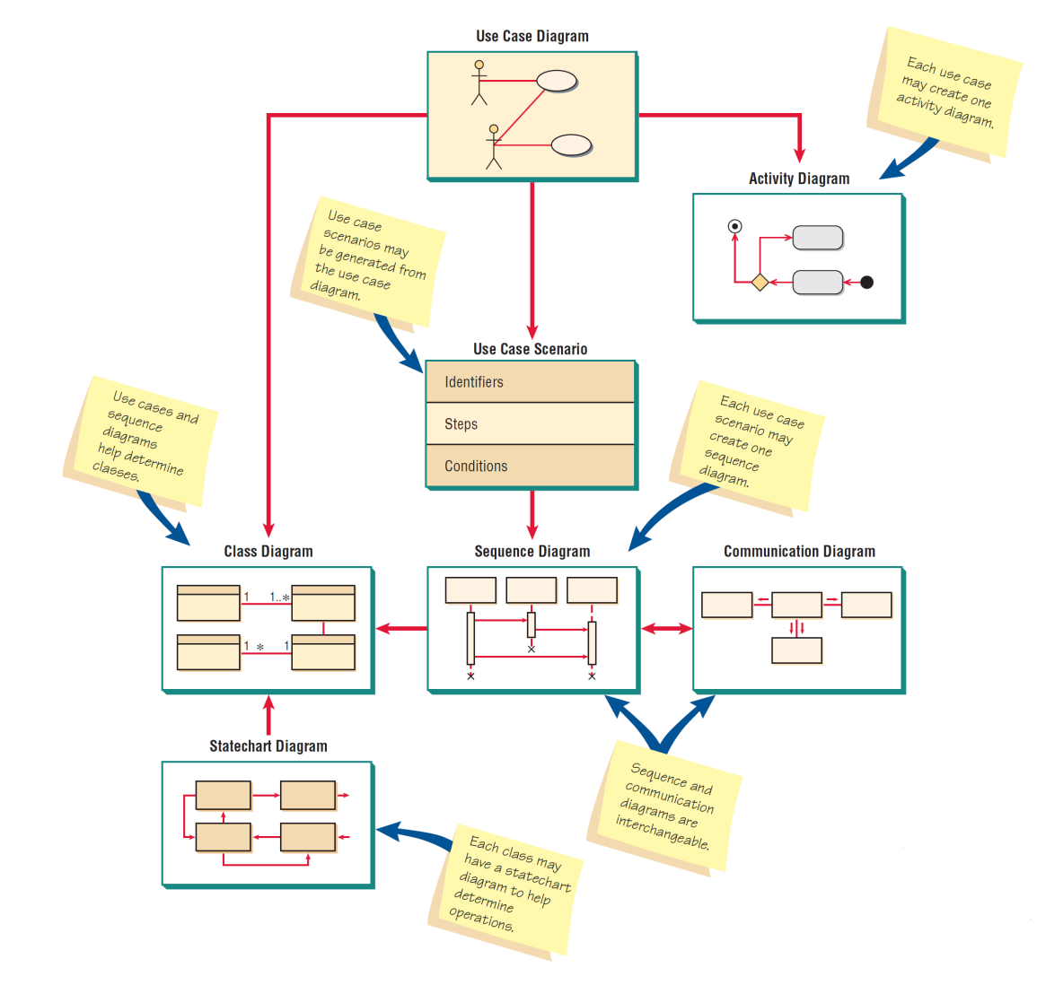
Figure 18.5 An overview of UML diagrams showing how each diagram leads to the development of other UML diagrams
Kendall & Kendall
18-<number>

Slide 26
Use Case Modeling
Describes what the system does, without describing how the system does it
Based on the interactions and relationships of individual use cases
Use case describes
  Actor
  Event
  Use case
Kendall & Kendall
18-<number>
Notes:
In a use case, an actor using the system initiates an event that begins a related series of interactions in the system.
Use cases are used to document a single transaction or event.

Slide 27
Figure 18.6 A use case example of student enrollment
Kendall & Kendall
18-<number>
Notes:
Use case diagrams provide the basis for creating other types of diagrams such as class diagrams and activity diagrams.

Slide 28
Activity Diagrams
Show the sequence of activities in a process, including sequential and parallel activities, and decisions that are made
Symbols
  Rectangle with rounded ends
  Arrow
  Diamond
  Long, flat rectangle
  Filled-in circle
  Black circle surrounded by a white circle
  Swimlanes
Kendall & Kendall
18-<number>
Notes:
An activity diagram is usually created for one use case and may show the different possible scenarios.

Slide 29
Figure 18.8 Specialized symbols are used to draw an activity diagram
Kendall & Kendall
18-<number>

Slide 30
Creating Activity Diagrams
Created by asking what happens first, what happens second, and so on
Must determine what activities are done in sequence or in parallel
The sequence of activities can be determined from physical data flow diagrams
Can be created by examining all the scenarios for a use case
Kendall & Kendall
18-<number>
Notes:
The sequence of activities can be determined from physical data flow diagrams – look for places that decisions are made, and ask what happens for each of the decision outcomes.
Can be created by examining all the scenarios for a use case – each path through the various decisions included on the use case is a different scenario.

Slide 31
Swimlanes
Useful to show how the data must be transmitted or converted
Help to divide up the tasks in a team
Makes the activity diagram one that people want to use to communicate with others
Kendall & Kendall
18-<number>
Notes:
Useful to show how the data must be transmitted or converted – such as from Web to server or from server to mainframe.
Help to divide up the tasks in a team – the analyst must ensure that the data that the various team members need is available and correctly defined.
The activity diagram provides a map of a use case, and allows the analyst to experiment with moving portions of the design to different platforms and ask “What if?” for a variety of decisions. The use of unique symbols and swinlanes makes this diagram one that people want to use to communicate with others.

Slide 32
This activity diagram shows three swimlanes: Client Web Page, Web Server, and Mainframe
Kendall & Kendall
18-<number>

Slide 33
Sequence Diagrams
Illustrate a succession of interactions between classes or object instances over time
Often used to show the processing described in use case scenarios
Used to show the overall pattern of the activities or interactions in a use case
Kendall & Kendall
18-<number>
Notes:
In practice, sequence diagrams are derived from use case analysis and are used in systems design to derive the interactions, relationships, and methods of the objects in the system.
Each use case scenario may create one sequence diagram, although sequence diagrams are not always created for minor scenarios.

Slide 34
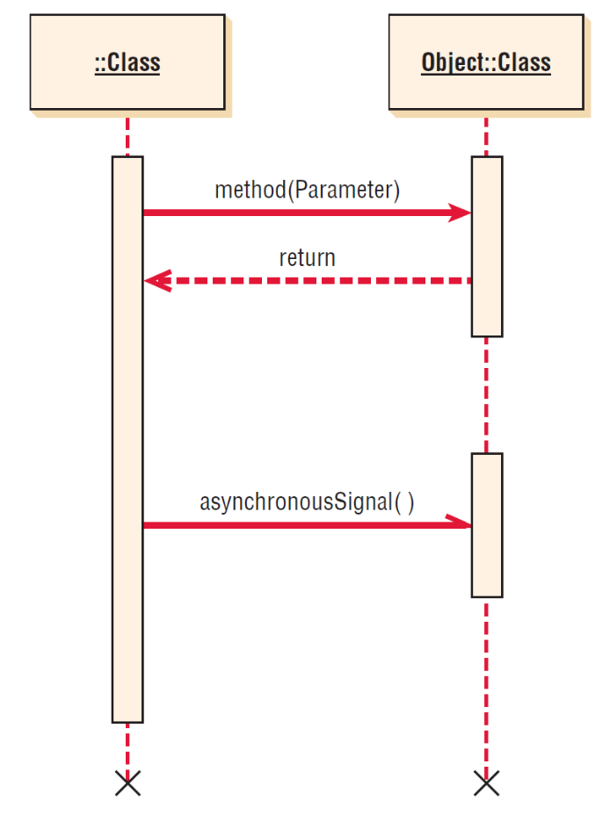
Figure 18.10 Specialized symbols used to draw a Sequence Diagram
Kendall & Kendall
18-<number>
Notes:
The boxes along the top of the diagram show the actors and classes or object instances.
The leftmost object is the starting object and may be a person, window, dialog box, or other user interface.
A vertical line represents the lifeline for the class or object, which corresponds to the time from when it is created through when it is destroyed.
Horizontal arrows show messages or signals that are sent between the classes.
Timing is displayed from top to bottom; the first interaction is drawn at the top of the diagram, and the interaction that occurs last is drawn at the bottom of the diagram.

Slide 35
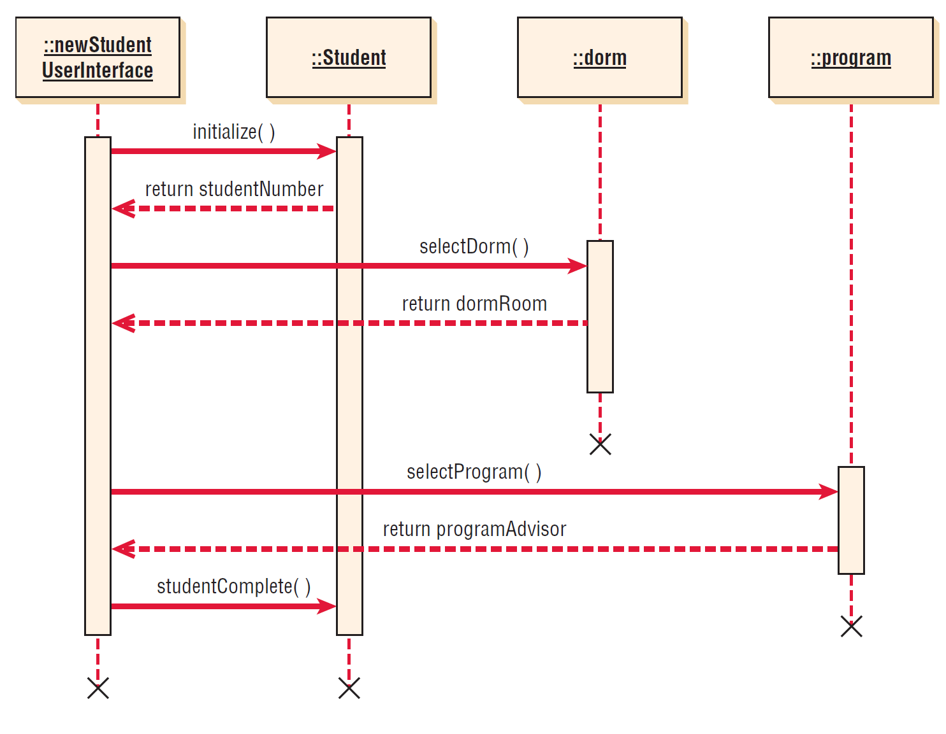
Figure 18.11 A sequence diagram for student admission. Sequence diagrams emphasize the time ordering of messages
Kendall & Kendall
18-<number>
Notes:
During the systems design phase, the sequence diagrams are defined to derive the methods and interactions between classes.

Slide 36
Class Diagrams
Show the static features of the system and do not represent any particular processing
Shows the nature of the relationships between classes
Shows data storage requirements as well as processing requirements
Kendall & Kendall
18-<number>

Slide 37
Class Diagrams (Continued)
Classes
Attributes
  Private
  Public
  Protected
Methods
  Standard
  Custom
Kendall & Kendall
18-<number>
Notes:
Classes – represented by a rectangle on the class diagram.
Attributes – what the class knows about the characteristics of the objects
Private – only available in the object.
Public – visible to other objects outside its class.
Protected - hidden from all classes except immediate subclasses.
Methods – small sections of code that work with the attributes
Standard – basic things that all classes of object know how to do.
Custom – designed for a specific class

Slide 38
Figure 18.13 A class diagram for course offerings. The filled-in diamonds show aggregation and the empty diamond shows a whole-part relationship
Kendall & Kendall
18-<number>

Slide 39
Method Overloading
Including the same method (or operation) several times in a class
The same method may be defined more than once in a given class, as long as the parameters sent as part of the message are different
Kendall & Kendall
18-<number>
Notes:
Example – pus sign.

Slide 40
Types of Classes
Entity classes
Interface classes
Abstract classes
Control classes
I ACE
Kendall & Kendall
18-<number>

Slide 41
Entity Classes
Represent real-world items
The entities represented on an entity-relationship diagram
Kendall & Kendall
18-<number>
Notes:
Represent real-world items – such as people, things , and so on.
The entities represented on and entity-relationship diagram – CASE tools will allow you to create a UML entity class from an entity on an E-R diagram.

Slide 42
Interface or Boundary Classes
Provide a means for users to work with the system
Human interfaces may be a display, window, Web form, dialogue box, touch-tone telephone, or other way for users to interact with the system
System interfaces involve sending data to or receiving data from other
Kendall & Kendall
18-<number>
Notes:
The attributes of these classes are those found on the display or report. The methods are those required to work with the display, or produce the report.

Slide 43
Abstract Classes
Linked to concrete classes in a generalization/specialization relationship
Cannot be directly instantiated
Kendall & Kendall
18-<number>

Slide 44
Control Classes
Used to control the flow of activities
Many small control classes can be used to achieve classes that are reusable
Kendall & Kendall
18-<number>
Notes:
Often a control class will be derived just to make another class reusable
example: logon process
The rules for creating sequence diagrams are that all interface classes must be connected to a control class and in a similar fashion all entity classes must be connected to a control class.

Slide 45
Kendall & Kendall
18-<number>
Notes:
1. Include the actor from the use case diagram in the enhanced sequence diagram. This will
be a stick figure from the use case diagram. There may be an additional actor on the right
side of the diagram, such as a credit card company or bank.
2. Define one or more interface classes for each actor. Each actor should have his or her own
interface class.
3. Create prototype Web pages for all human interfaces.
4. Ensure each use case has one control class, although more may be created during the
detailed design. Look for that control class and include it in the sequence diagram.
5. Examine the use case to see what entity classes are present. Include these on the diagram.
6. Realize that the sequence diagram may be modified again when doing detailed design,
such as creating additional Web pages or control classes (one for each Web form
submitted).
7. To obtain a greater degree of reuse, consider moving methods from a control class to an
entity class.

Slide 46
Relationships
The connections between classes
  Associations
  Whole/part
Kendall & Kendall
18-<number>
Notes:
Associations – a structural connection between classes or objects.
Whole/part – when one class represents the whole object and other classes represent parts.

Slide 47
Associations
The simplest type of relationship
Association classes are those that are used to break up a many-to-many association between classes
An object in a class may have a relationship to other objects in the same class, called a reflexive association
Kendall & Kendall
18-<number>

Slide 48
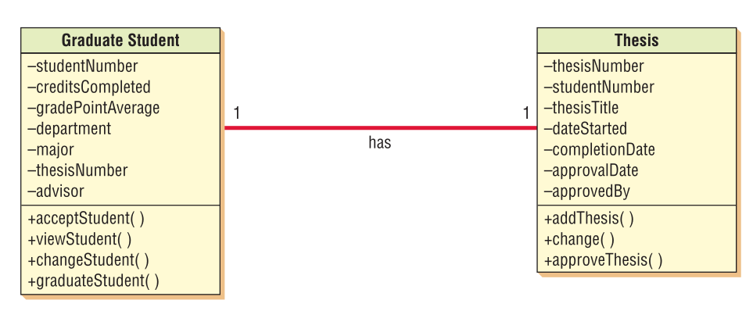
Association
Kendall & Kendall
18-<number>

Slide 49
Association
Kendall & Kendall
18-<number>

Slide 50
Association
Kendall & Kendall
18-<number>

Slide 51
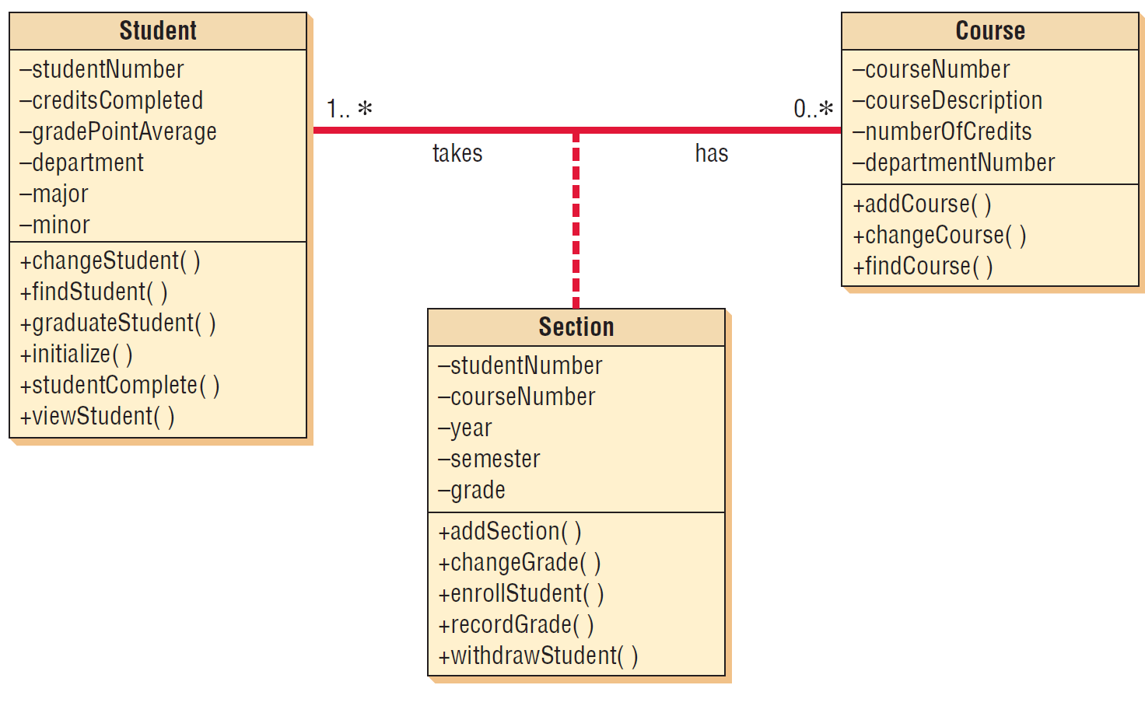
Association Class
Kendall & Kendall
18-<number>

Slide 52
Whole/Part Relationships
When one class represents the whole object, and other classes represent parts
Categories
  Aggregation
  Collection
  Composition
Kendall & Kendall
18-<number>
Notes:
When one class represents the whole object, and other classes represent parts – the whole acts as a container for the parts.

Slide 53
Aggregation
A “has a” relationship
Provides a means of showing that the whole object is composed of the sum of its parts
Kendall & Kendall
18-<number>

Slide 54
Collection
Consists of a whole and its members
Members may change, but the whole retains its identity
A weak association
Kendall & Kendall
18-<number>
Notes:
Examples are a library with books or a voting district with voters.

Slide 55
Composition
The whole has a responsibility for the parts, and is a stronger relationship
If the whole is deleted, all parts are deleted
Kendall & Kendall
18-<number>
Notes:
Example: an insurance policy with riders.

Slide 56
Figure 18.13 A class diagram for course offerings. The filled-in diamonds show aggregation and the empty diamond shows a whole-part relationship
Kendall & Kendall
18-<number>

Slide 57
Figure 18.19 An example of whole-part and aggregation relationships
Kendall & Kendall
18-<number>

Slide 58
Generalization/Specialization Diagrams
Generalization
Inheritance
Polymorphism
Abstract classes
Messages
Kendall & Kendall
18-<number>

Slide 59
Generalization
Describes a relationship between a general kind of thing and a more specific kind of thing
Described as an “is a” relationship
Used for modeling class inheritance and specialization
General class is a parent, base, or superclass
Specialized class is a child, derived, or subclass
Kendall & Kendall
18-<number>
Notes:
For example: a car is a vehicle, a truck is a vehicle

Slide 60
Inheritance
Helps to foster reuse
Helps to maintain existing program code
Kendall & Kendall
18-<number>
Notes:
Helps to foster reuse – because the code is used many times.
Helps to maintain existing program code – this allows the analyst to define attributes and methods once but use them many times, in each inherited class.

Slide 61
Polymorphism
The capability of an object-oriented program to have several versions of the same method with the same name within a superclass/subclass relationship
The subclass method overrides the superclass method
When attributes or methods are defined more than once, the most specific one is used
Kendall & Kendall
18-<number>
Notes:
The subclass method overrides the superclass method –
the subclass inherits a parent method but may add to it or modify it.
the subclass may change the type of data, or change how the method works.
When attributes or methods are defined more than once, the most specific one is used – the compiled program walks up the chain of classes, looking for methods.

Slide 62
Abstract Classes
Abstract classes are general classes
No direct objects or class instances, and is only used in conjunction with specialized classes
Usually have attributes and may have a few methods
Kendall & Kendall
18-<number>
Notes:
Abstract classes are general classes – used when gen/spec is included in the design.

Slide 63
Kendall & Kendall
18-<number>
Notes:
Person is an abstract class, with no instances.

Slide 64
Packages
Containers for other UML things
Show system partitioning
Can be component packages
Can be physical subsystems
Use a folder symbol
May have relationships
Kendall & Kendall
18-<number>
Notes:
Containers for other UML things – such as use cases or classes.
Show system partitioning indicating which classes or use cases are grouped into a subsystem (logical packages).
Can be component packages – contain physical system components, or use case packages, containing a group of use cases.
Use a folder symbol – with the package name either in the folder tab or centered in the folder.
May have relationships – may include associations and inheritance.

Slide 65
Figure 18.23 Use cases can be grouped into packages
Kendall & Kendall
18-<number>

